Slide 1

COVIDgilance Presented by Paul Kazalski, Flomo Kokro, Will Giordano, Maria-Elena Gorini, Meghna Agnish

Slide 2
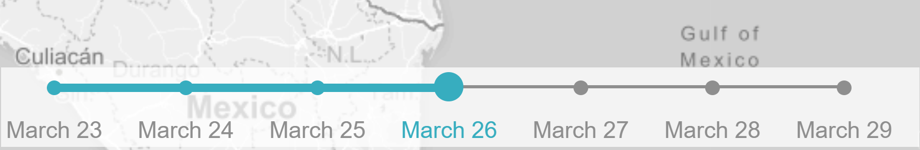
Leaflet timeline-slider
Who we should thank:
Created by Sol Vitkin (GitHub: svitkin)
Maintained by Dennis Wilhelm
What it is:
A time-based interaction overlay
(from leafletjs.com ToC)
L.control.timelineSlider({ })
How it works:
generates the interactive slider icon (with customization options)
allows the user to attach a function related to said slider
accepts additional functions not related to slider value
Other options:

Slide 3

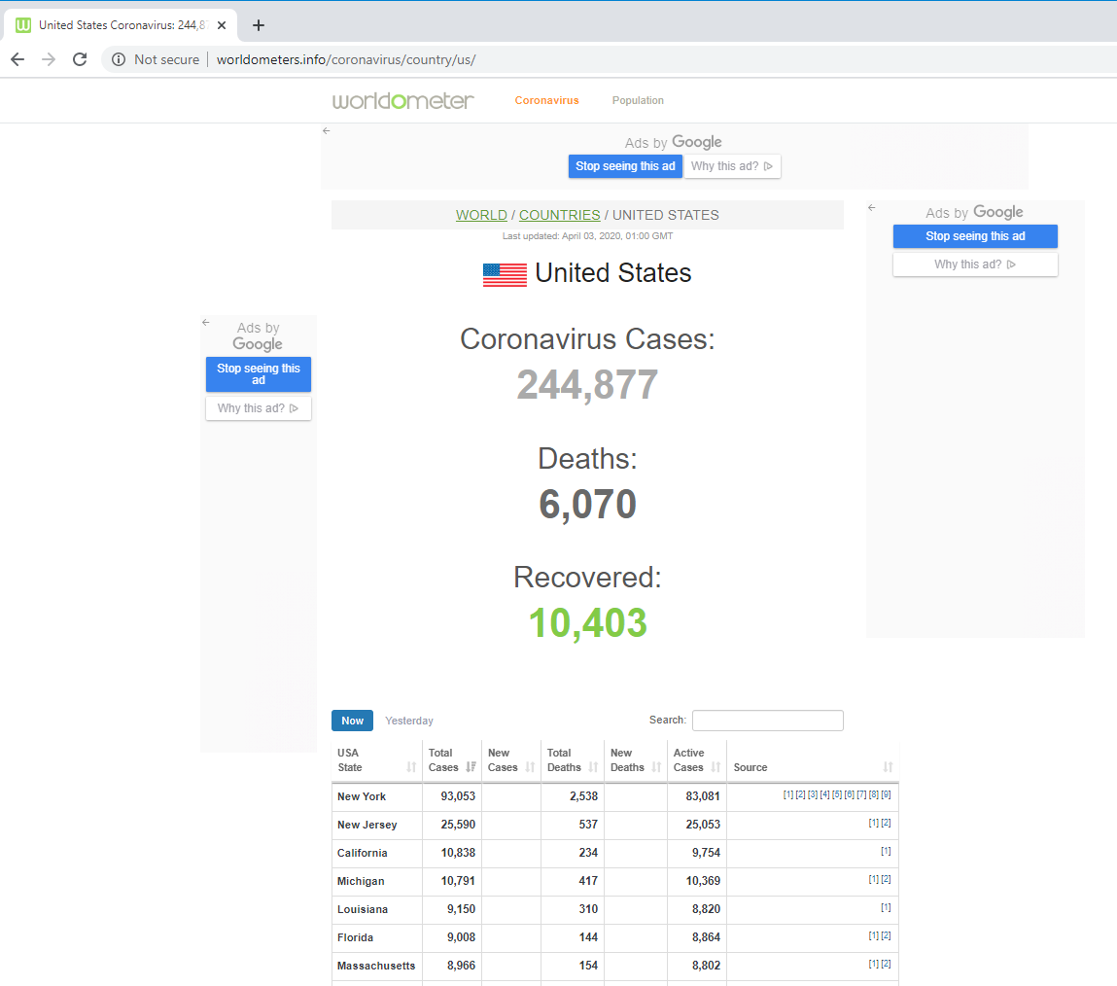
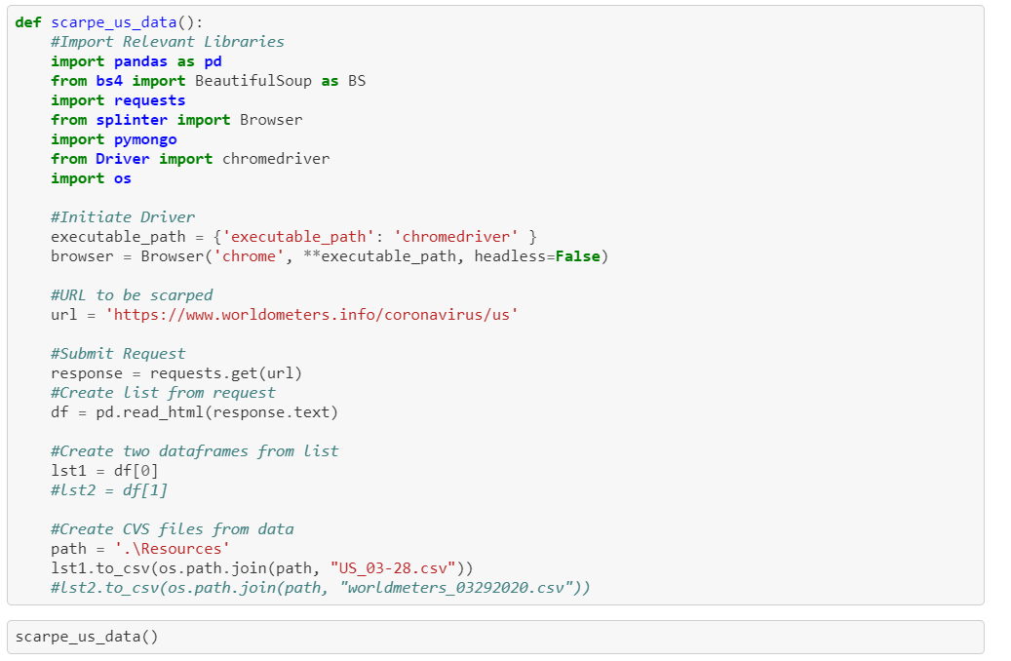
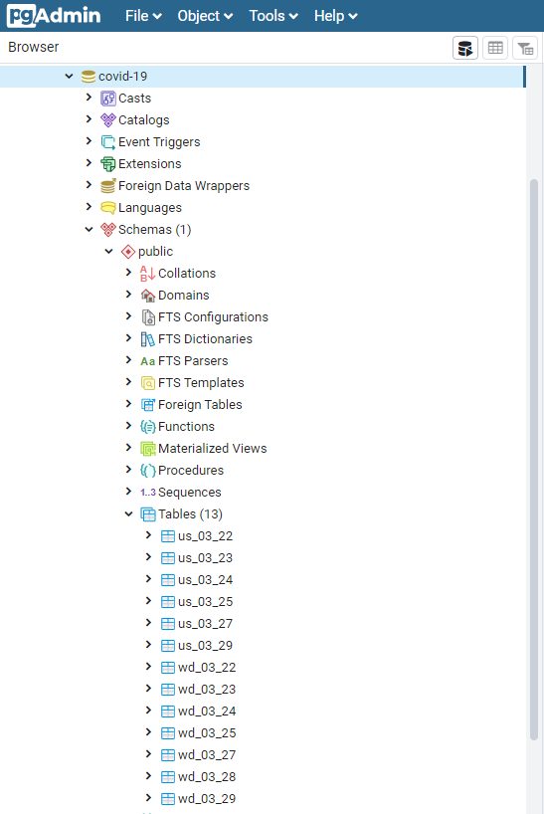
Data
Each US file had 54 lines of data. Each World file had 202 lines of data.
We pulled data from March 22, 2020 to April 1, 2020 (11 days of data).

Slide 4
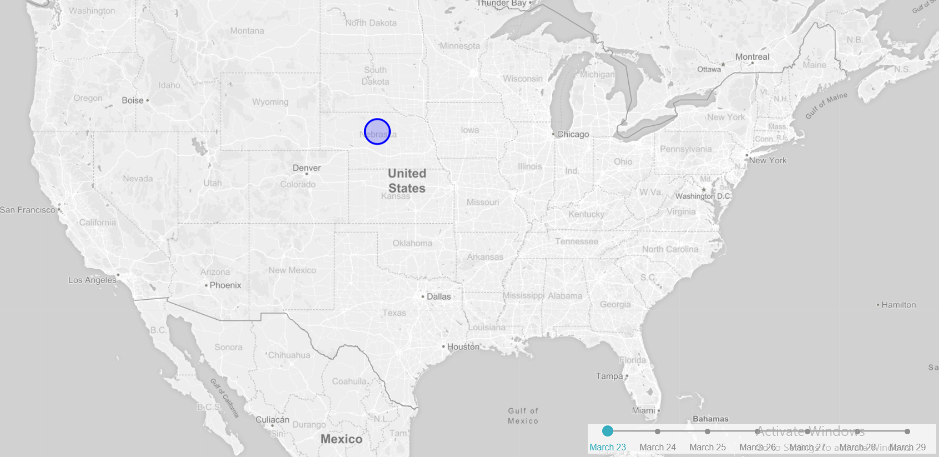
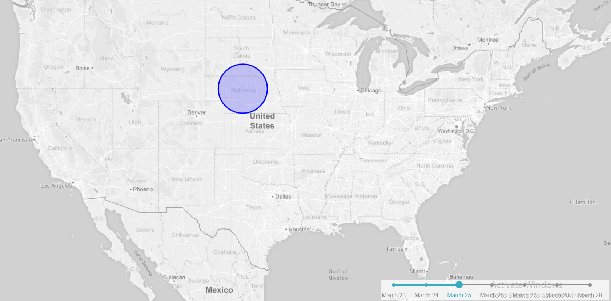
Timeline-slider Example
producer = function( {label, value, map, exclamation} ) {
for (var j = 0; j < circles.length; j++) {
if (circles[j])
{myMap.removeLayer(circles[j])};}
for (var i = 1; i < 8; i++) {
if (value == i)
{circles[i-1].addTo(myMap)};}
};
L.control.timelineSlider({
timelineItems: ["March 23", "March24",
"March 25", "March 26", "March 27",
"March 28", "March 29"],
changeMap: producer,
extraChangeMapParams: {exclamation: "Hello World!"}
}).addTo(myMap);

Slide 5
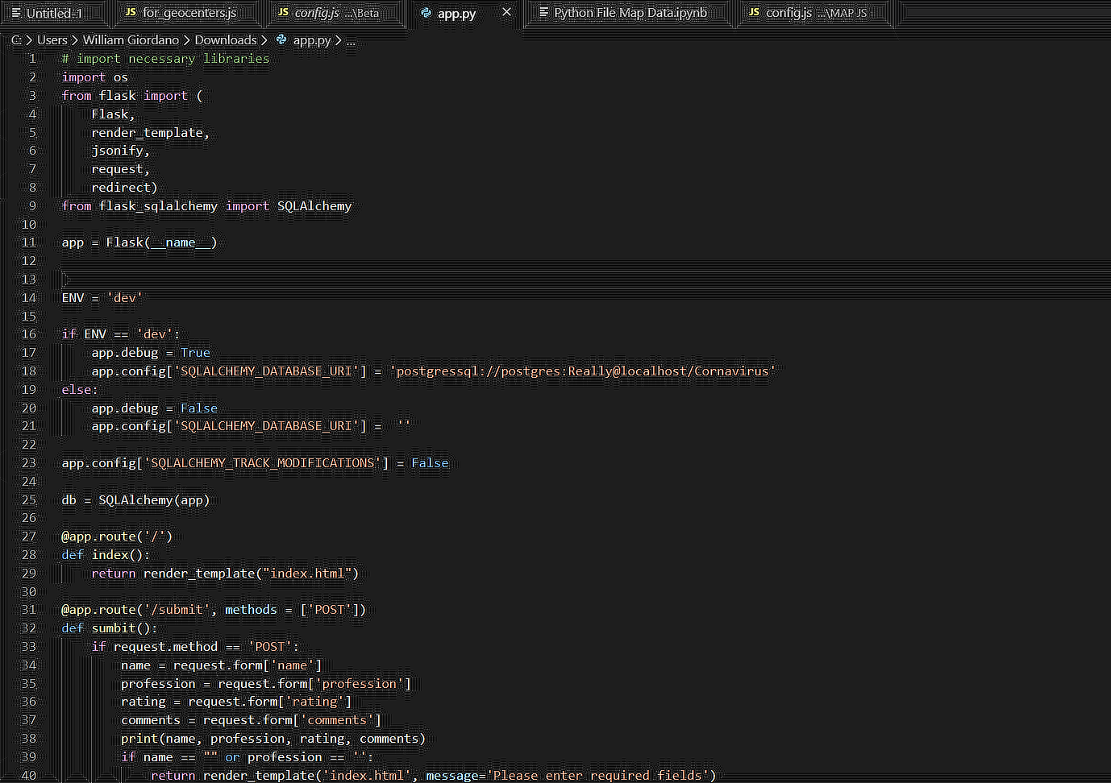
Flask File 1
Creates:
The output data
Sending data from Python to Javascript
Receiving data in Python from Javascript
Creating an image dynamically using a special Flask route Utilized

Slide 6
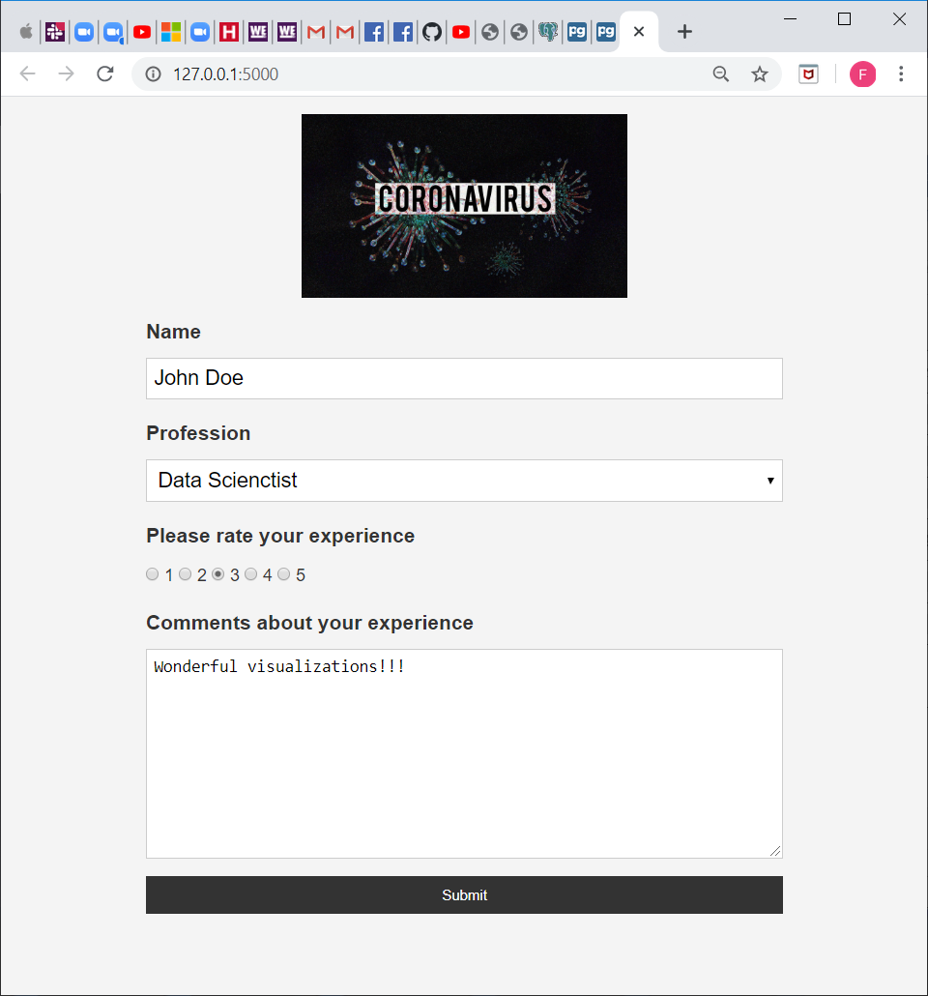
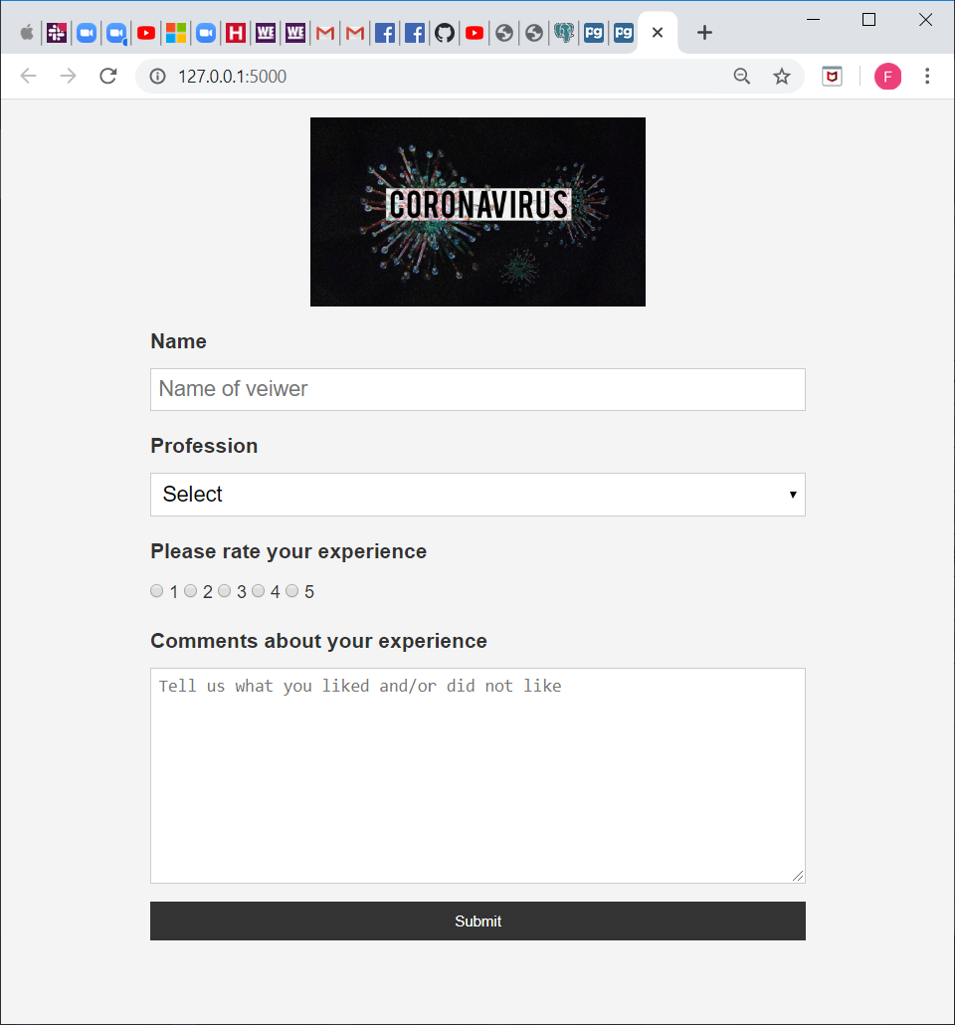
Flask File 2
The output data
Utilizing the app.py function in Javascript to run the Flask

Slide 7
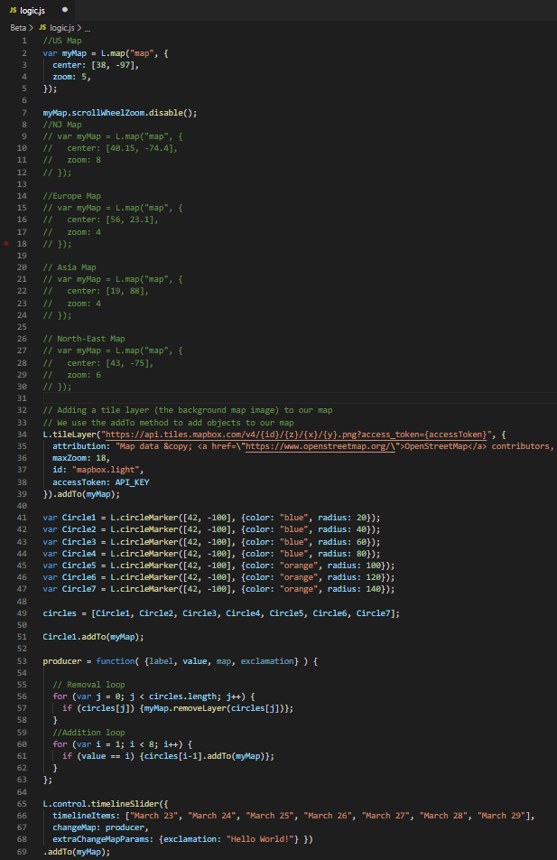
Javascript File 1
Creates:
The map
Links the slider library to the circles do they update by date
Utilized:
Map-box
Leaflet
Slider Library

Slide 8
Javascript File 2
Creates:
The circles based on the number of those infected in each state for each date
Utilized:
The API that was utilized was implemented by Map-box
Leaflet
Scraped Data

Slide 9
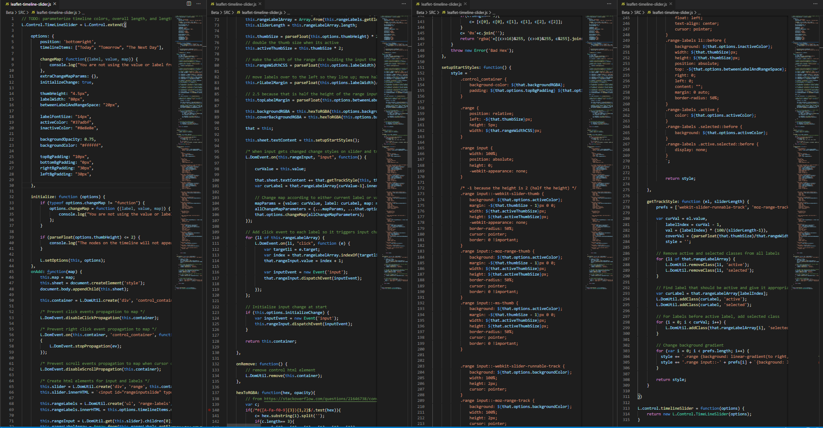
Slider Library

Slide 10
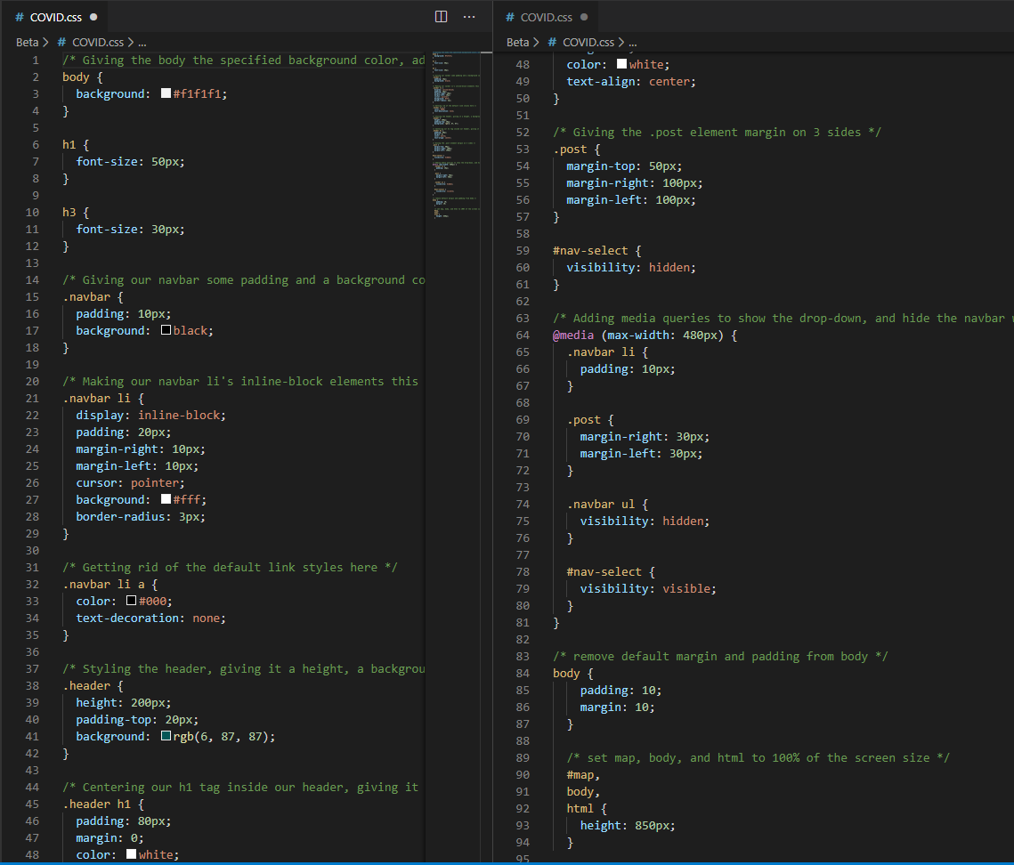
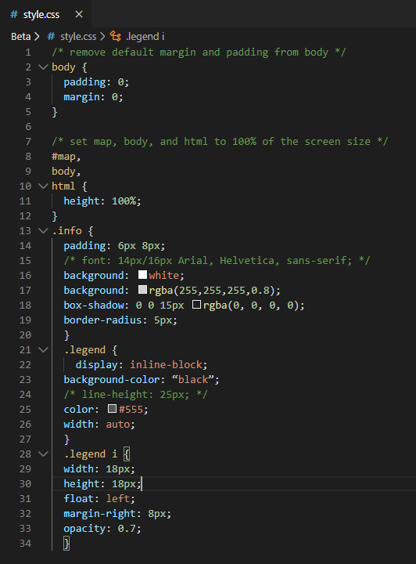
CSS

Slide 11
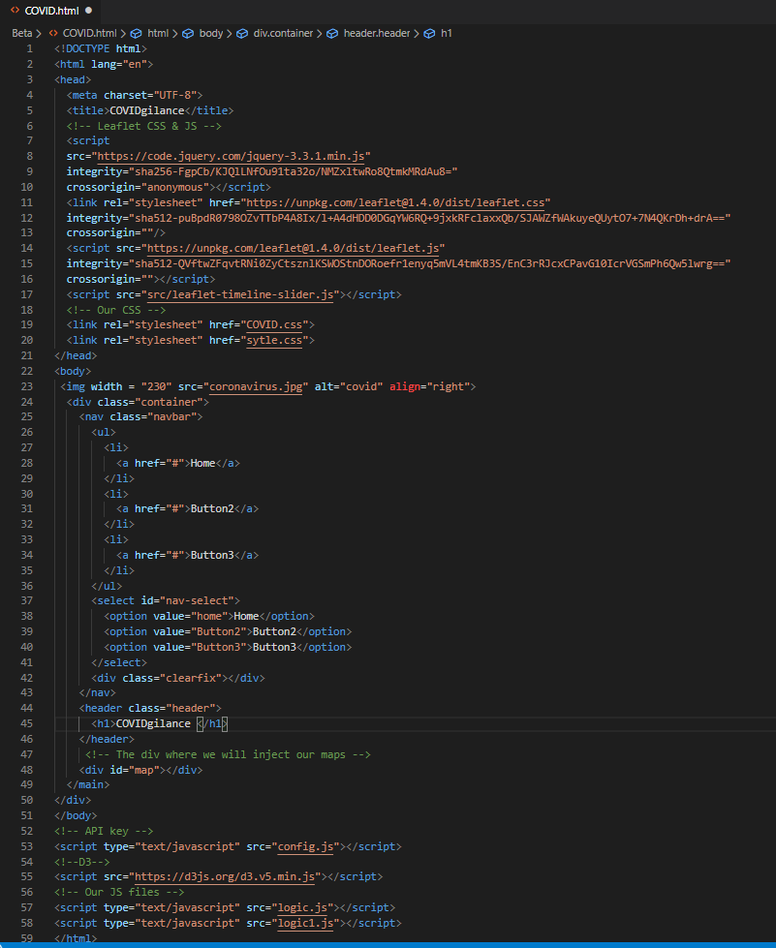
HTML
(Insert link: then click on link to show our visualizations)

Slide 12
Conclusions
In our project we included code utilizing Web Scraping, Leaflet, Python-Flask, API, HTML, CSS, SQL, JavaScript, and Jupyter Notebook
Exponential Growth of the COVID-19 virus was concentrated in areas of New York state, New Jersey, as well as New York City and other city metropolis nationwide

Slide 13

Questions
(No Coughing Please)

